Slide 1
Spectroscopy

Slide 2
Spectroscopy is the study of the interaction between electromagnetic radiation and matter. The matter can be atoms, molecules or ions.

Slide 3
Spectrometer
Spectrometer is something which can be used to measure the presence of particular compound or particle in a molecule.

Slide 4
Spectrum
Spectrum is a plot of the amount of light absorbed by a sample versus the wavelength of the light.
The amount of light absorbed is called the absorbance.

Slide 5
Electromagnetic radiation
EM is a form of energy that is all around us.
EM is a form of energy and has both electrical and magnetic characteristics.
Electricity and magnetism were once thought to be separate forces.
James clerk maxwell developed a unified theory of electromagnetism.
The study of electromagnetism deals with how electrically charged particles interact with each other and with magnetic fields.

Slide 6
Electromagnetic radiation
Electromagnetic radiation is a form of energy and has both electrical and magnetic characteristics
The electric and magnetic fields in n electromagnetic wave oscillate along directions perpendicular to the propagation direction of the wave

Slide 7
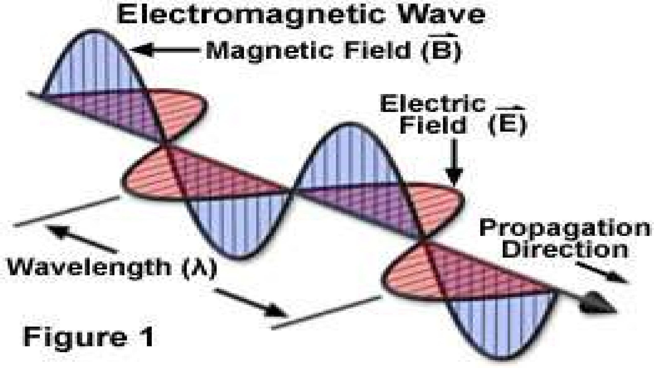

Slide 8
Electomagnetic spectrum
A short wavelength means that the frequency will be higher because one cycle can pass in a shorter amount of time according to the university of wisconsin.
Similarly a longer wavelength has a lower frequency because each cycle takes longer to complete.

Slide 9
Various terms...
Frequency :- number of waves produced each second (measured in Hz).
Wavelength (λ) :- the distance between two successive waves (measured in m).
Amplitude :- is the maximum distance a wave extends beyond its middle position.
Wave number: no of waves per cm.

Slide 10
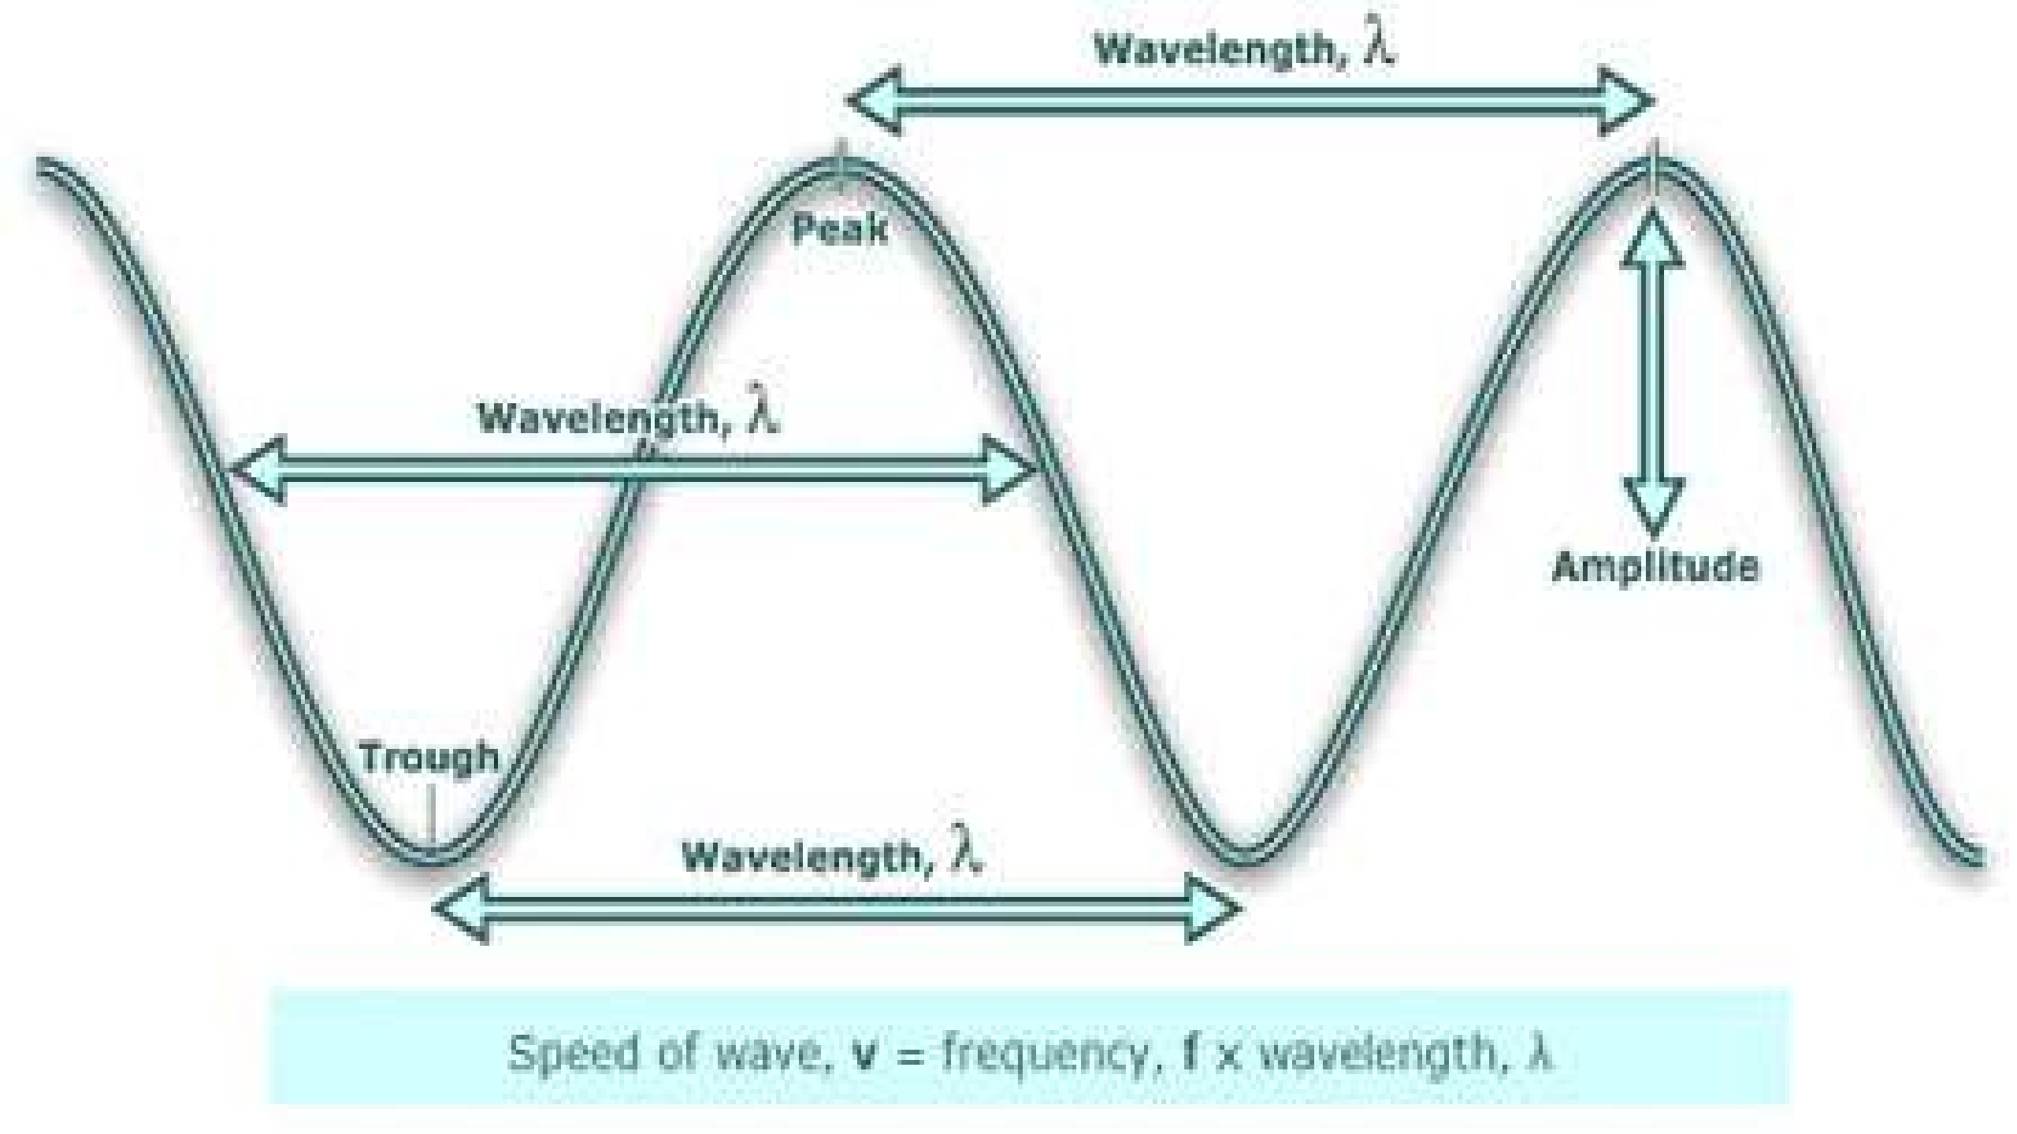

Slide 11
Electromagnetic spectrum
Electromagnetic spectrum ranges from very short wavelength (gamma rays) to very long wavelengths(radio waves).
The visible region of the spectrum extends approximately over the wavelength range 400-700nm.
The shorter wavelength being the blue end of the spectrum and the longer wavelength the red.

Slide 12
Electromagnetic spectrum
The wavelength between 400 and 200nm make up the near ultraviolet region of the spectrum.
The wavelength above 700nm to approximately 2000nm the ultraviolet region.

Slide 13
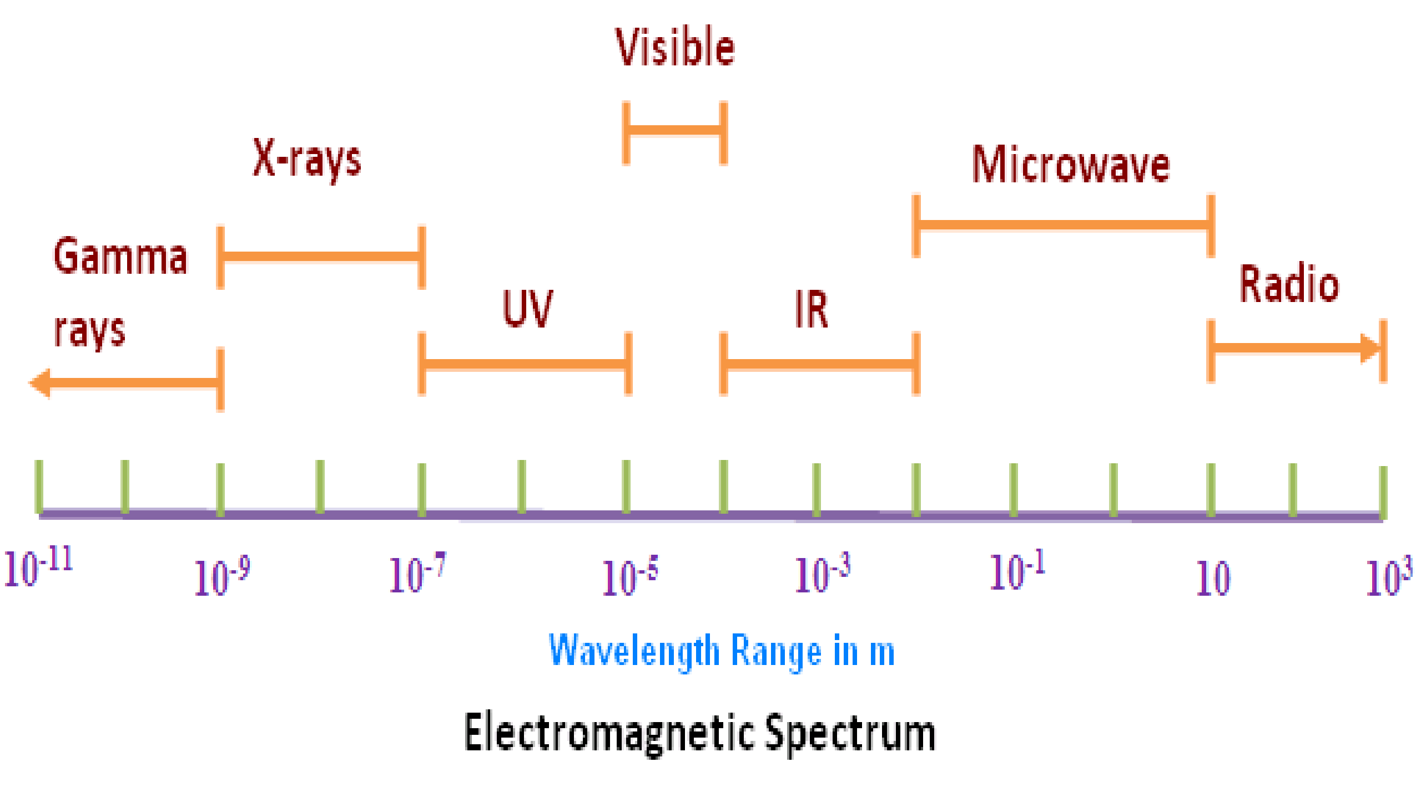

Slide 14
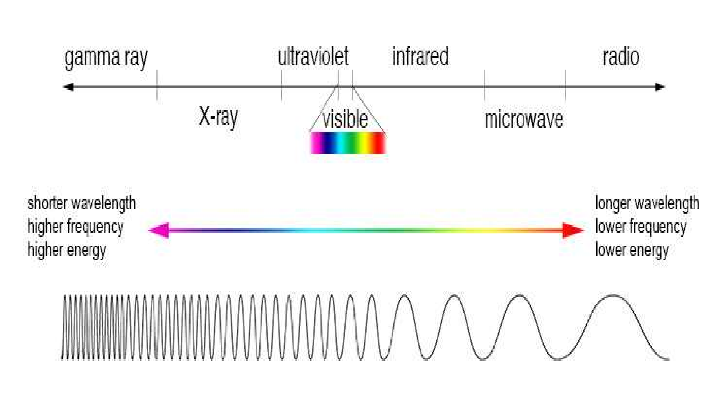

Slide 15
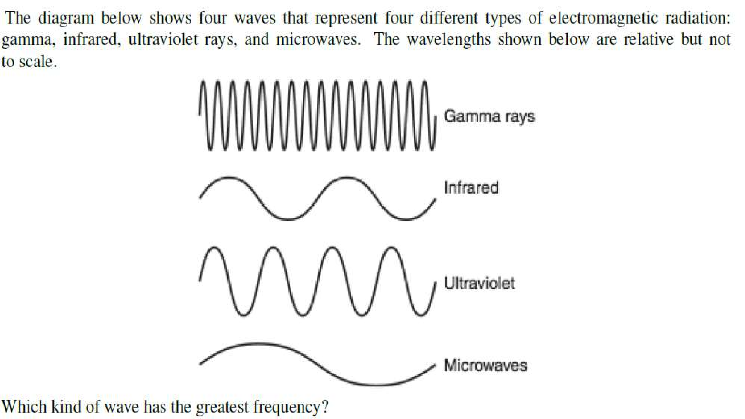

Slide 16
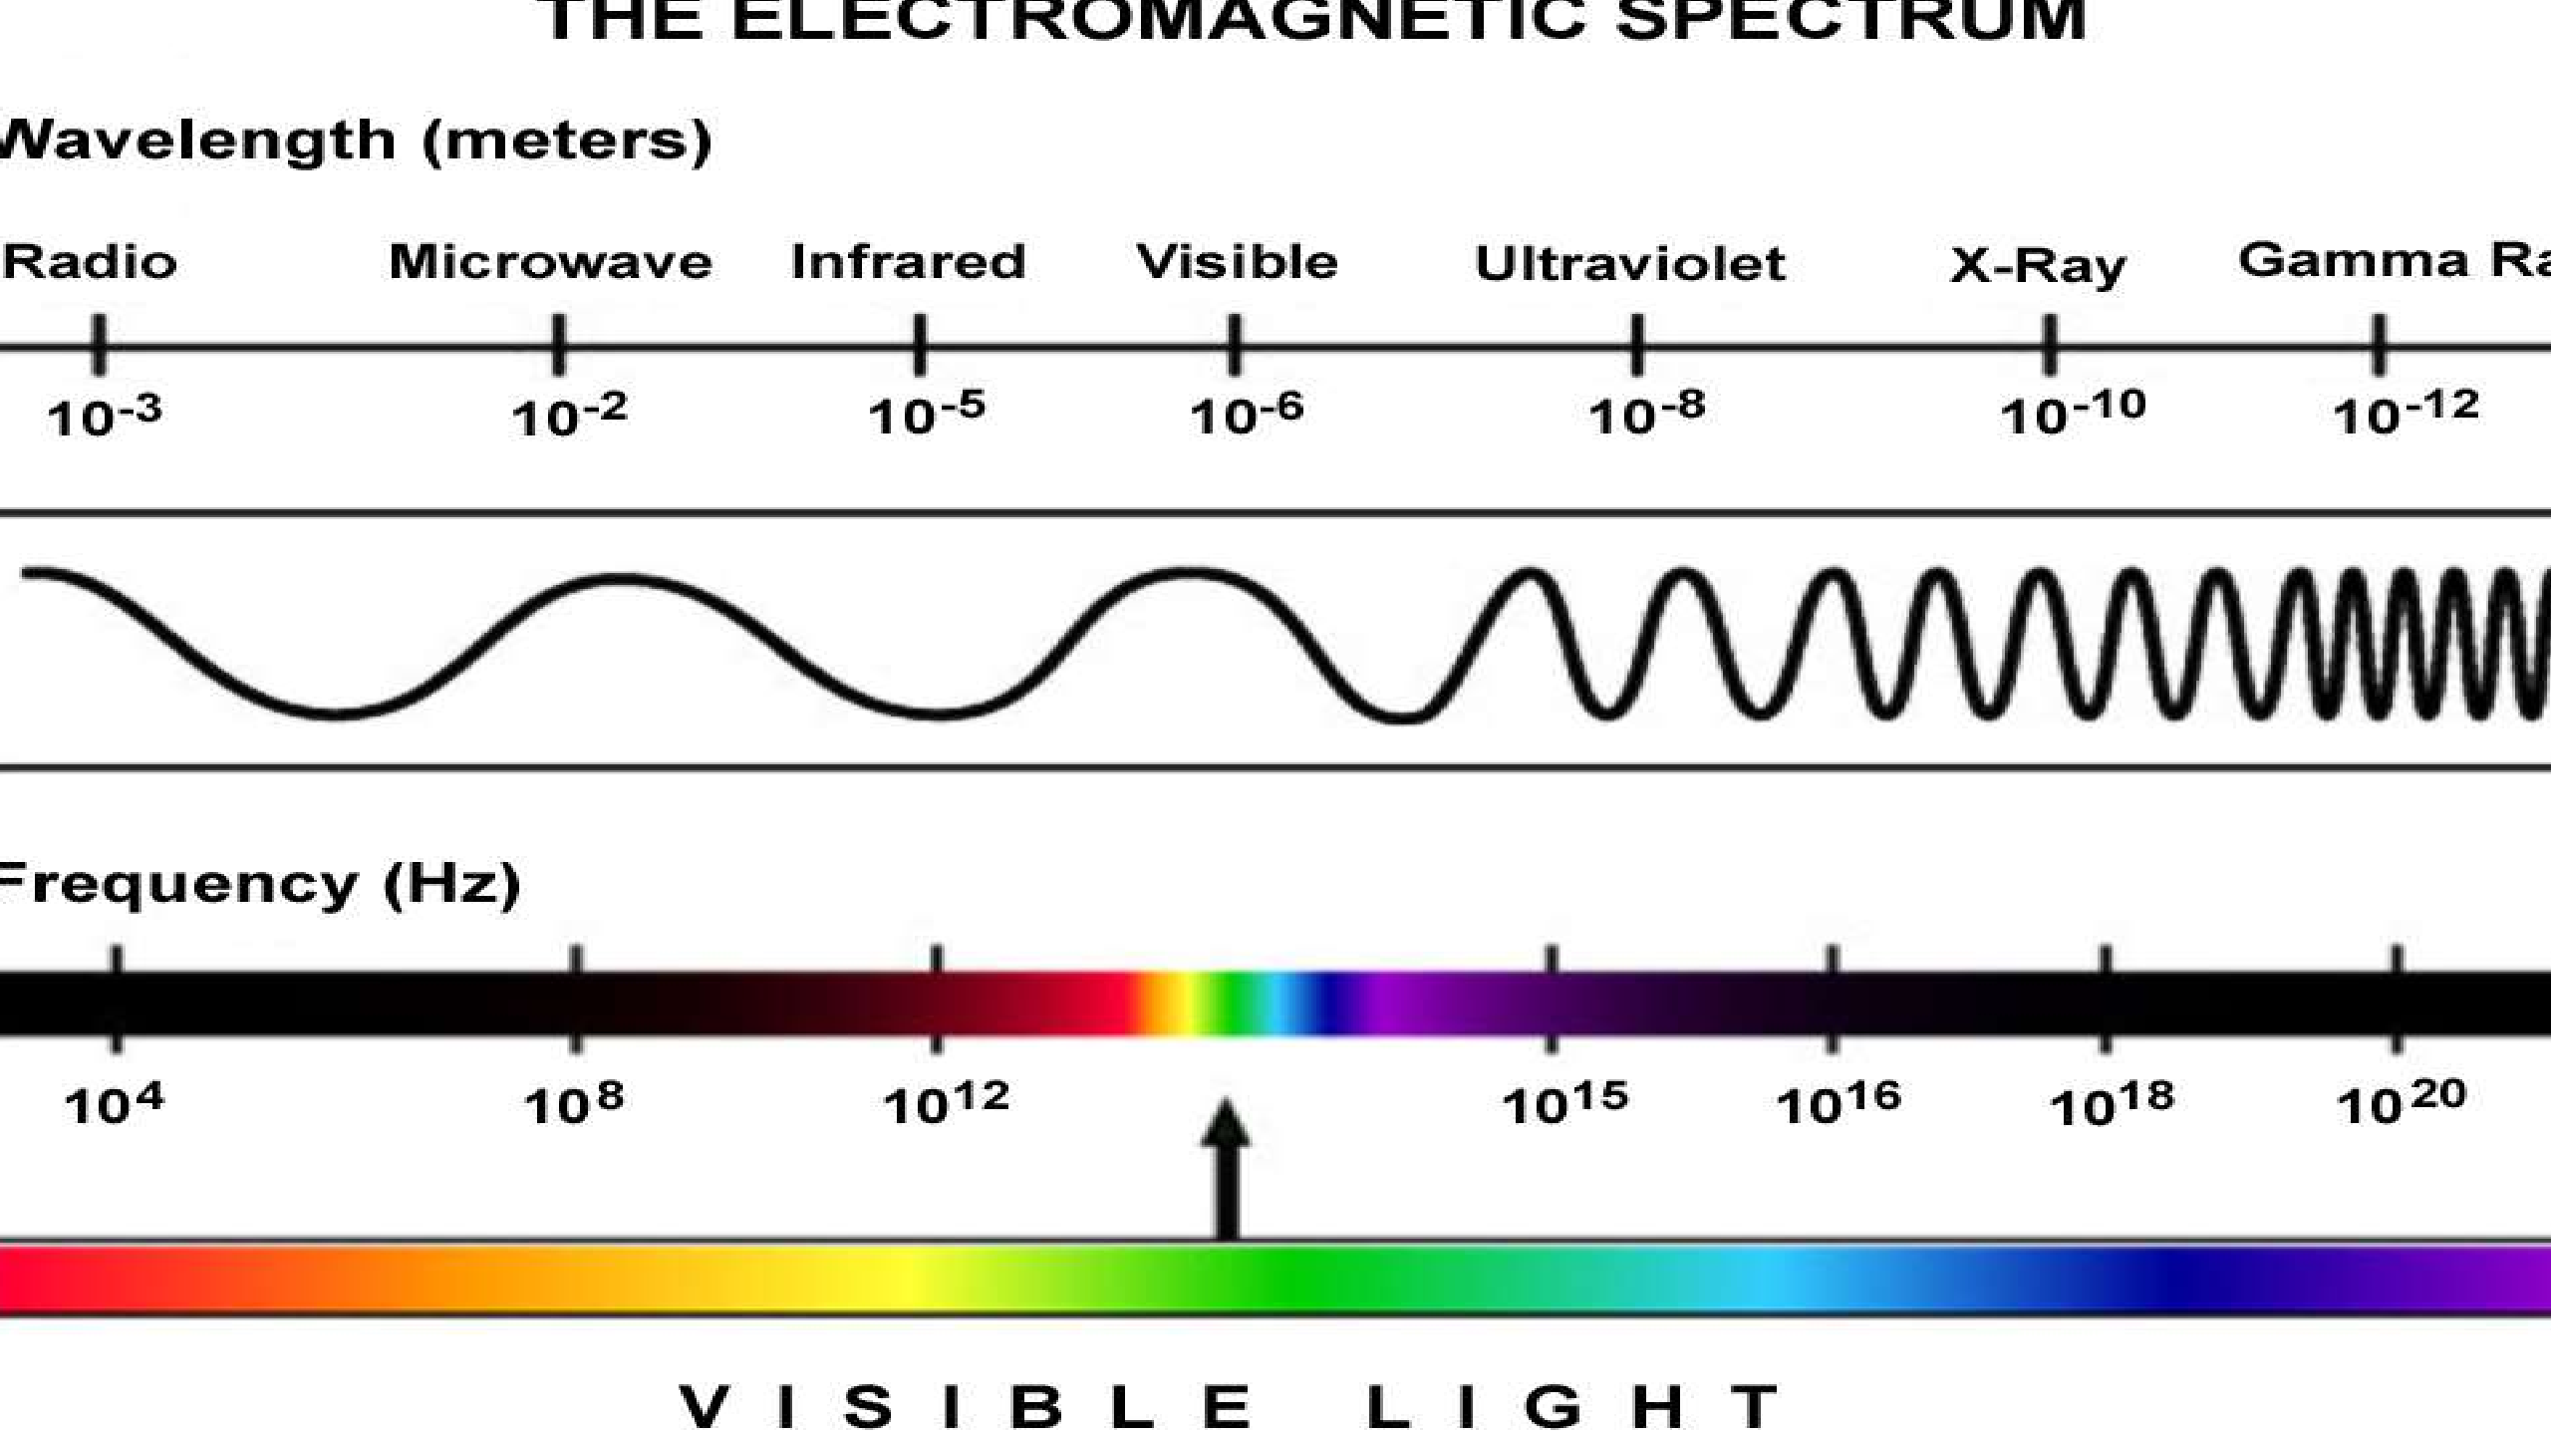

Slide 17





Interaction of electromagnetic radiation
With matter

Slide 18
The nature of the interaction between radiation and matter may include-
absorption
emission
scattering
They help in the study of matter with respect to
qualitative study
quantitative study

Slide 19
Interaction with matter...
The effect of electromagnetic radiation on interaction with matter depends on energy associated with the radiation.
Very energetic radiations (UV and x-ray) may cause an electron to be ejected from the molecules.
Radiation in the infrared region of the spectrum have much less energy they can cause vibrations in molecules.

Slide 20
Interaction with matter...
Microwave radiation is even less energetic than infrared radiation it can neither induce electronic transition in molecules nor can it cause vibrations it can only cause molecules to rotate.
Ultraviolet, visible - electronic transitions
Infrared - molecular vibrations
Microwave - molecular rotation

Slide 21
Types of spectroscopy
When radiation meets matter, the radiation is either scattered, emitted or absorbed
so they are of three types
absorption spectroscopy
scattering spectroscopy
emission spectroscopy

Slide 22
Absorption spectroscopy
In absorption spectroscopy an electromagnetic radiation is absorbed by an atom or molecule
Which undergoes transition from a lower energy state to a higher energy or excited state.
Absorption occurs only when the energy of radiation matches the difference in energy between two energy levels.

Slide 23
Scattering spectroscopy
Scattering spectroscopy measures certain physical properties by measuring the amount of light that a substance scatters at certain wavelengths .
One of the most useful applications of light scattering spectroscopy is RAMAN SPECTROSCOPY.

Slide 24
Emission spectroscopy
Atoms or molecules that are excited to high energy levels can decay to lower levels by emitting radiation.
The substance first absorbs energy and then emits this energy as light.
Emission can be induced by sources of energy such as flame or electromagnetic radiation.

Slide 25
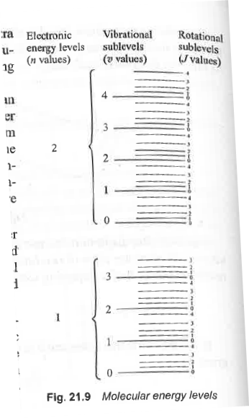

Slide 26
Principles of absorption spectroscopy
A = - log (T)
Absorption of light by a sample

Slide 27
Principles of absorption spectroscopy
Lamberts law:
It states that when monochromatic light passes through a transparent medium, the intensity of transmitted light decreases exponentially as the thickness of absorbing material increases.
Beer’s law:
It stats that the intensity of transmitted monochromatic light decreases exponentially as the concentration of the absorbing substance increases.

Slide 28
Beer-lamberts law
The Beer-Lambert law states that the amount of light absorbed by a substance dissolved in a fully transmitting solvent is directly proportional to the concentration of the substance and the path length.
A = a x b x c
where
a = the absorptivity of the substance
b = path length
c = concentration of the substance
When working in concentration units of molarity, the Beer-Lambert law is written as:
A = £ x b x c
Where £ is the wavelength-dependent molar absorptivity coefficient with units of M-1 cm-1.
As, ε and b, both are constant, then it can be written that, A α c

Slide 29
Selection Rules for Electronic Transitions
If there is a change in the number of unpaired electrons in going from the ground state to the excited state, the transition is referred to as spin or multiplicity-forbid.
If the transition occurs within a set of d- or p-orbitals (i.e., a transition in which redistribution of electrons takes place within a particular orbital or there is change in the azimuthal quantum number), it is termed as Laporte forbidden transition. The molecule must have centre of symmetry.

Slide 30
Selection Rules for Electronic Transitions
However, transitions become allowed because
(i) Vibrational transitions during d-d transition may change dipole moment and become allowed as low intensity bands.
(ii) In complexes, there may be mixing of d- and p-orbitals and the transition t2g to eg is not pure d → d transition, but is mixed dp - dp transition.
(iii) If there is overlap of metal d-orbitals with ligand orbitals, the pure d character of metal d-orbitals is lost and the d-d transition may have higher intensity than expected.

Slide 31
Selection Rules for Electronic Transitions
Complexes are coloured
Complexes are coloured if the ion does not possess perfect octahedral symmetry and the centre of symmetry is not preserved; d- and p- orbitals are hybridised and the transition occurs only between dp levels.
Vibronic transitions
Even if the symmetry is perfect octahedron, some of the molecules during a normal vibration get distorted at any time and also d- and p-orbitals are mixed in a symmetric configuration, then less intense transition (Emax 5 ~ 25) is observed. This transition is referred to as vibronically allowed transition and the effect is called vibrational coupling.
Some d-d transitions are Laporte forbidden while others are both Laporte and spin-forbidden. For example, the transitions t¹_{2g} e0_{g} → t⁰_{2g} e¹_{g} occurring in [Ti(H₂O)₆]³⁺ Laporte forbidden. Transitions t²_{2g} e²_{g} → t²_{2g} e³_{g} in (Mn(H₂0)₆]²⁺ ion and t⁵_{2g} e²_{g} → t²_{2g} e³_{g} in [Co(H₂O)₆]²⁺ ion are Laporte as well as spin-forbidden d-d transitions.

Slide 32
SPECTRUM OF HYDROGEN ATOM

Slide 33
The selection rules (i.e., the conditions for which the transition are allowed) for hydrogen atom are
Δn = Any integer Δl = +l or -l, Δj = 0,± 1
²S_{1/2} → ²P_{1/2} (Δj = 0), ²S_{1/2} → ²P_{3/2} (Δj = +1)

Slide 34
Rotational Spectroscopy
Rotational energy of a molecule is quantized and it is much smaller than the vibrational and electronic energies. The energy levels for the rotational motion of a molecule are obtained by
J= 0, 1, 2, 3
where I is the moment of inertia of the molecule about its axis of rotation and J is the rotational quantum number. The equation (2.5) shows that energy separation between rotational energy levels is of the order of 25 J mol-1 (1 to10 cm-1). Since these rotational transitions lie in the microwave region of the spectrum, the rotational spectra is also called the Microwave Spectra.

Slide 35
Conditions to obtain pure rotational spectrum
For microwave absorption, the molecule must possess a permanent dipole moment. A rotating heteronuclear diatomic molecule such as HC1 (or CO, NO, H₂O etc.) will give rise to a sinusoidally varying component of electric dipole moment vector, which can interact with the electric field vector of the microwave radiation. Hence, heteronuclear diatomic and polyatomic molecules with permanent dipole moment give rise to a spectrum and are said to be microwave active.

Slide 36
Conditions to obtain pure rotational spectrum
However, polyatomic molecules having no dipole moment may be made to undergo vibrational rotational transition because of the fact that exciting radiation can induce an oscillating dipole moment in such type of molecules. The homonuclear diatomic molecules such as H₂, N₂, O₂, Cl₂ which do not have permanent dipole moment (or dipole moment is zero) do not give pure rotational spectra and are said to be microwave inactive.

Slide 37
Rotational spectra of rigid diatomic molecule
For a diatomic molecule AB of atomic masses m₁ and m₂ at an internuclear distance r, if m₁ is at a distance r₁ from the centre of gravity and m₂ is at a distance r₂ from the centre of gravity of the molecule, then
r₁ + r₂ = r
and m₁ r₁ = m₂ r₂
Hence,
Since

Slide 38
Rotational spectra of rigid diatomic molecule
where c is the velocity of light. Equation is usually given by,
EJ = BJ(nJ+1)cm⁻¹
where B = h/8π²Ic is known as the rotational constant.

Slide 39
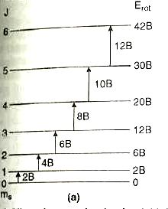
(a)Allowed energy levels of a rigid diatomic rotor showing electric dipole allowed transitions and (b) the resulting absorption spectrum
For a diatomic rigid rotor only transitions in which J changes by one unit that is ΔJ = ± 1 are allowed and all other transitions are forbidden. Thus the selection rule for rotational spectra is ΔJ = ± 1.

Slide 40
VIBRATIONAL (INFRA RED) SPECTROSCOPY
Simple harmonic oscillator (Vibrational motion)
The vibrational motion resembles the motion observed for a ball attached to a spring that is harmonic oscillator which obeys Hook’s law. That is the force, the spring exerts on the particle is a proportional to displacement from the equilibrium position, x(x=0). Hook’s law relates the restoring force, F as F=-fx where f is a force constant. Therefore, the potential energy of the particle will be
V(x)=-Fdx or V(x)= ∫ fx dx
Thus V(x)=1/2 fx²

Slide 41
Application of Newton’s second law gives the familiar equation of simple harmonic motion. The equation of motion according to classical mechanics is
F= md²x / dt²
Hence, restoring force md²x / dt²= -fx

Slide 42
Vibrational motion of a diatomic molecule

Slide 43
Vibrational motion of a diatomic molecule
The displacement coordinates are x₁ and x₂ in Fig. The extension of the spring is (x₂-x₁). The restoring force is then given by
F=-f(x₂-x₁), f is a force constant .......... (1)
The motion can be expressed in terms of Newton's law as follows:
.......... (2)
Similar equations can be written for compression. The solution of these equations (like harmonic oscillator) shows that
.......(3)
where v₀ is the fundamental natural frequency of the system and μ is the reduced mass of the two particle system. Here the fundamental frequency depends on the force constant and the reduced mass of the system.

Slide 44
Vibrational motion of a diatomic molecule
According to the quantum mechanical model, the potential energy is given by
V(x) = l/2f(x2-x1)2 .......(4)
Substituting it in the Schrodinger wave equation we get
.......(5)
where the displacement x=(x2-x1). Thus the vibrational energy of diatomic molecule is
.......(6)
v is called the vibrational quantum number and the frequency v0 is given by equation (3). Converting energy into spectroscopic units, cm-1, we get
.......(7)

Slide 45
Vibrational motion of a diatomic molecule
Different values of vibrational quantum number, v can be derived from equation (7).

Slide 46
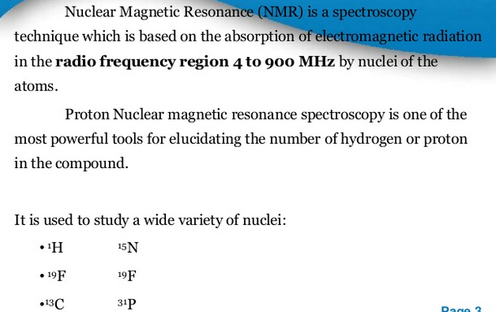
NMR Spectroscopy

Slide 47
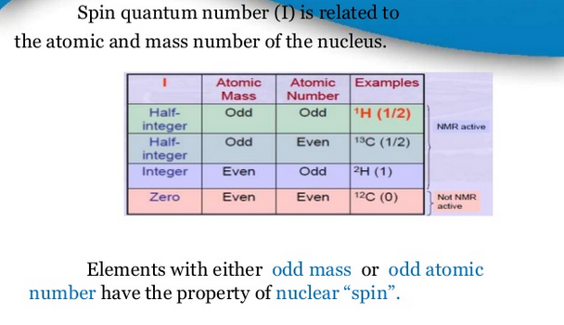
NMR Spectroscopy

Slide 48
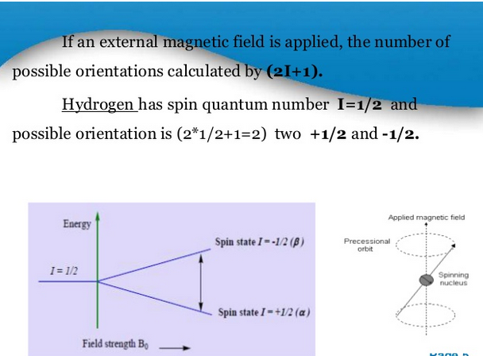

Slide 49
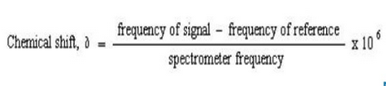
Chemical Shift
A chemical shift is defined as the difference in parts per million (ppm) between resonance frequency of the observed proton and tetramethylsilane (TMS) hydrogens.
TMS is the most common reference compound in NMR, it is set at ∂=0 ppm.

Slide 50
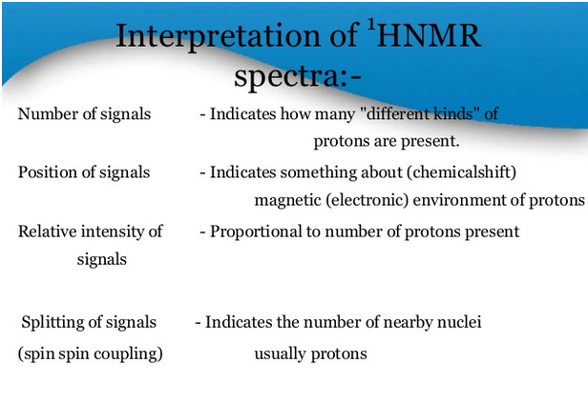

Slide 51
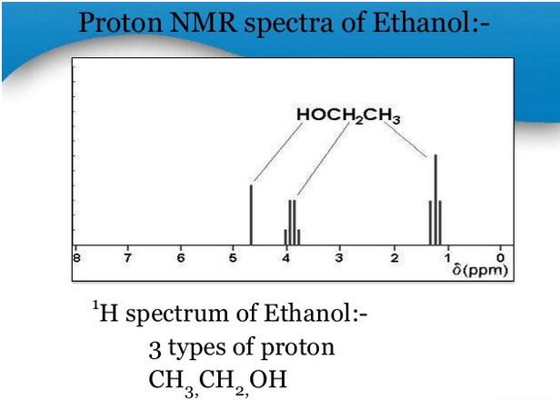

Slide 52
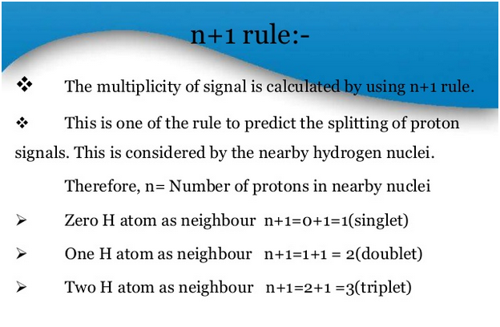

Slide 53
Pascal's Triangle giving Intensities of NMR Signals
Number of Protons, n | Number of NMR lines | Relative Intensities
0 | 1 | 1 1 1 1 2 1 1 3 3 1 1 4 6 4 1 1 5 1 0 1 0 5 1 etc
1 | 2
2 | 3
3 | 4
4 | 5
5 | 6
etc | etc

Slide 54
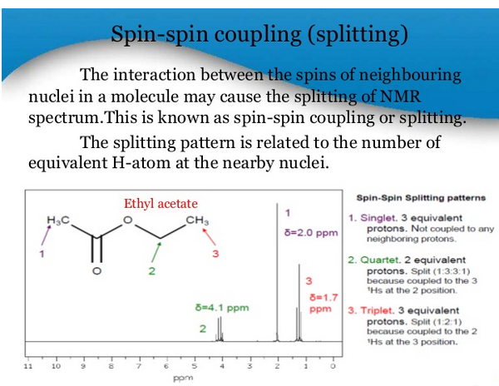

Slide 55
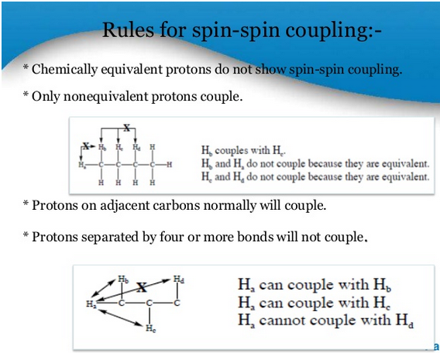

Slide 56
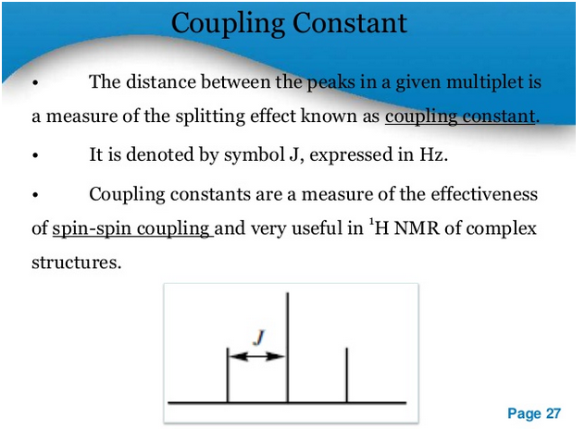

Slide 57
How many peaks will appear?
CH₃-CH₂-OH
CH₃-CO-CH₂-CH₃
CH₃-CHO

